Slide 1
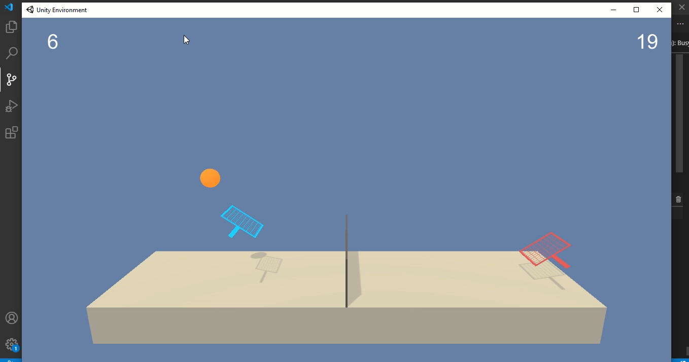
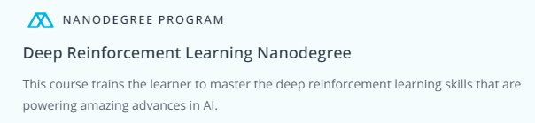
Trained Multi-Agent Play – Deep Reinforcement Learning
This is an internal work as part of Udacity’s Nanodegree Program–Deep Reinforcement Learning using Unity Env.
Aims to make the multiple AI agents to make collaborative play to maximize their rewards
Target: Avg 0.5 over 100+ episodes
Env solved –at 155th Episodes with Max Rewards of 2.6

